Slide 1

Hotel Management System
Presented By:
Vaibhavi Shastri
Muskaan Nayan Jain
Deepthi Sri Kunapareddi
Mythri Sreepada
Shruthi Salla
Date- 03 MAY 2024
Prof. Theyab Alhwiti

Slide 2


Outline
Introduction
Methods
Results /Solutions
Discussions and Conclusion
Business Implications
Limitations

Slide 3
Background
As the hospitality industry becomes more complex, the role of technology to help streamline operations and automate processes is becoming increasingly important.
This can be accomplished, by centralizing and streamlining important processes like reservations, check-ins, check-outs, room assignments, billing, and guest services.
Thus, our project focuses on leveraging database management principles and SQL analysis techniques to enhance various aspects of hotel management systems.

Slide 4
Introduction
Hotel Management System
Streamlined Reservation Management
Enhanced Guest Management
Operational Efficiency in Room Management
Inventory oversight
Financial Transactions

Slide 5
Introduction- User Profile
Hotel Managers
Front Desk Staff
House Keeping and Maintenance Staff
Finance Department
Marketing Team

Slide 6

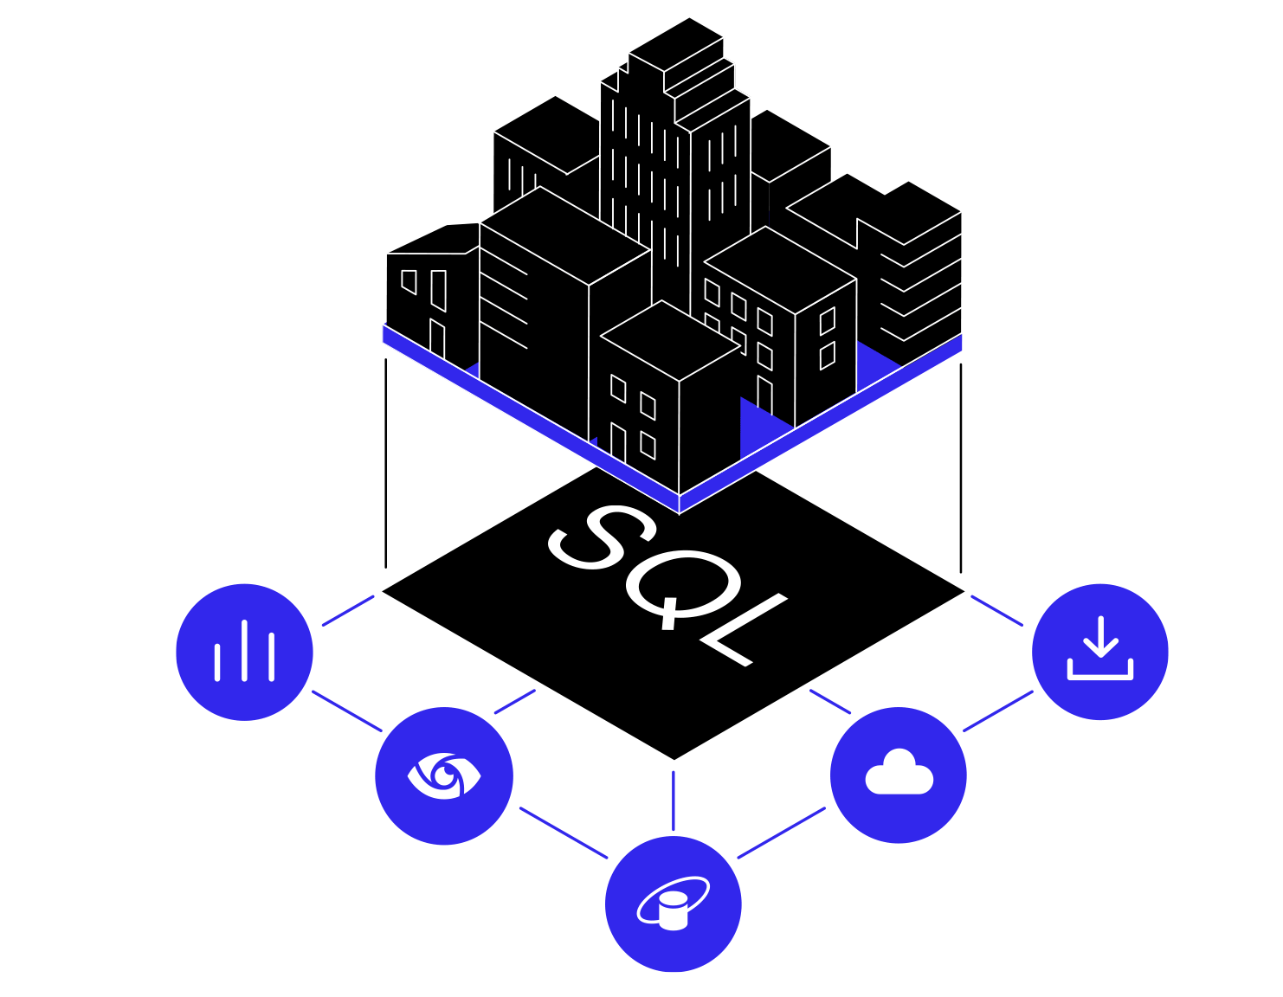
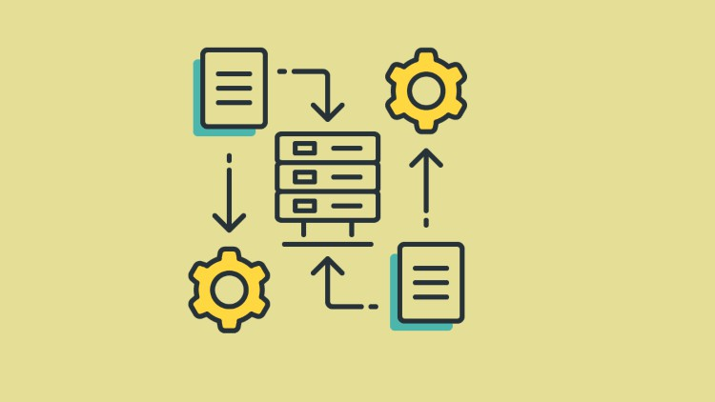
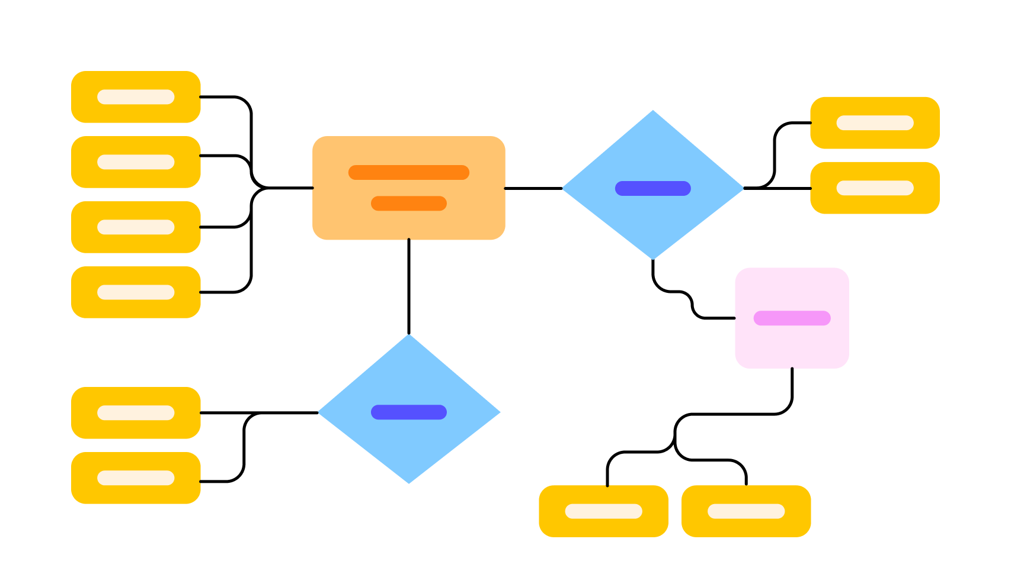
Methods – to facilitate hotel operations efficiently
Implemented Database to draw tables and relationships
Designed Comprehensive Database Structure
Identified business problem and business rules
Facilitated the use of SQL queries to demonstrate system capabilities

Slide 7
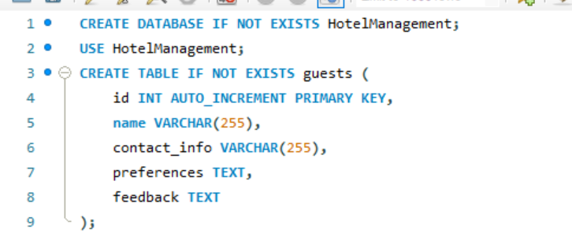
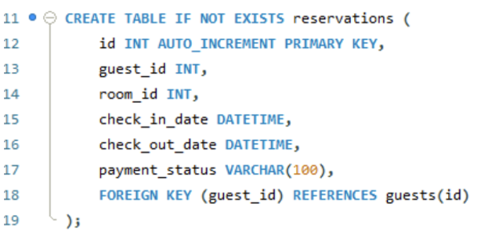
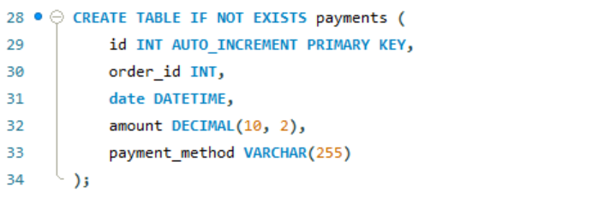
Results/solutions
Examining the Dataset:
Create a SQL Table

Slide 8
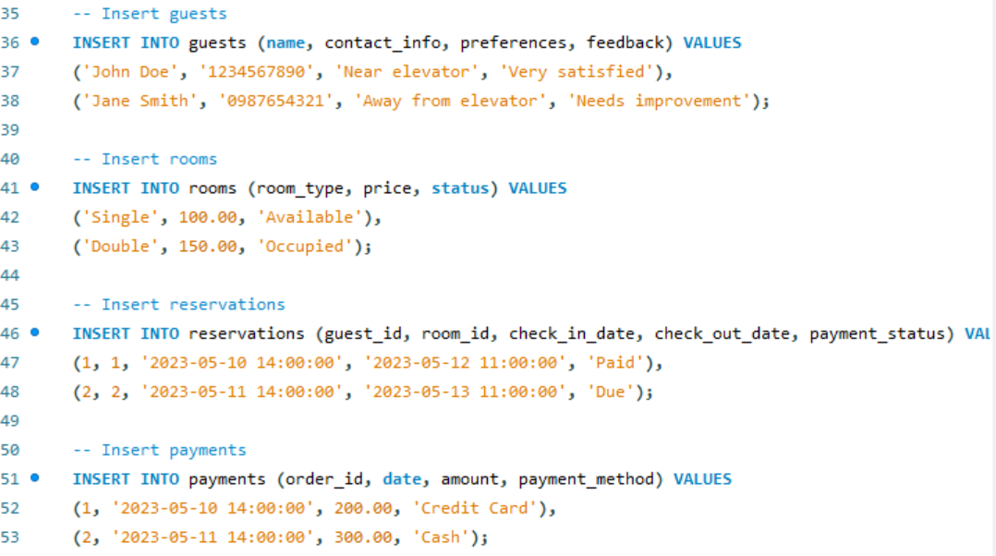
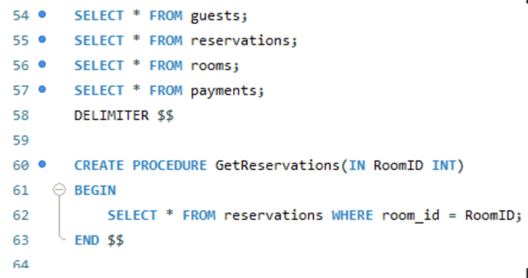
Results/solutions
Importing the Data

Slide 9
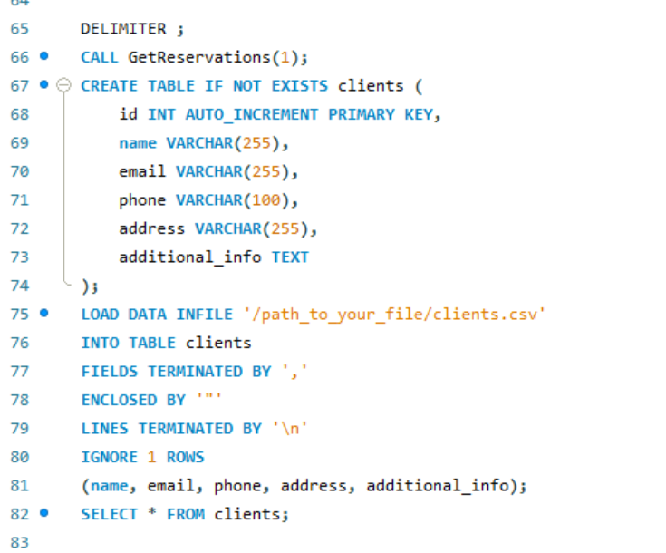
Results/solutions
Verifying The data:
The command retrieves all entries from the clients table, allowing you to visually inspect the data.

Slide 10
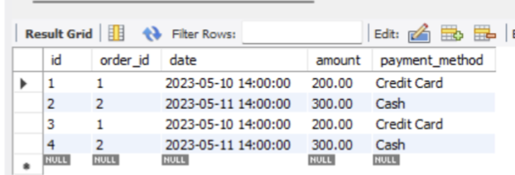
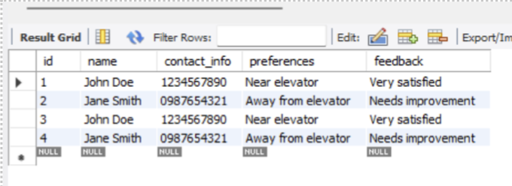
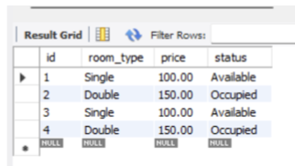
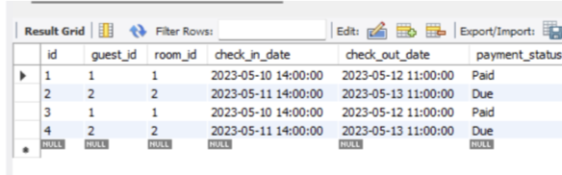
Final Output

Slide 11
Client Goals and requirements
Client Goals
User Requirement
Reservation Management
Guest Personalization
Revenue Management
Security and Privacy
Guest Management
Room Management
Reservation Handling
Billing and Payment Processing
Reporting and Analytics

Slide 12
Database Objective
Data Integrity and Normalization
Scalability and Performance Optimization
Data Security and Concurrency Control
Backup, Recovery, and Integration
Maintainability and Reporting

Slide 13
Business Rule
Guest Reservation Management
Inventory Management
Billing Automation
Room Inventory and Availability Management

Slide 14
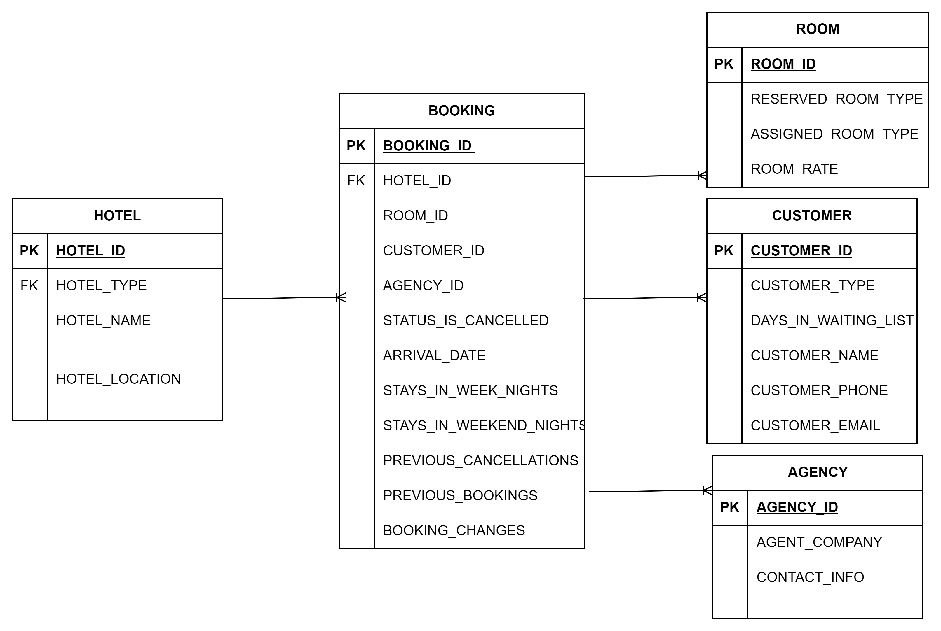
Results/solutions - ER Diagram

Slide 15

Insights on Findings
Comprehensive hotel management system with modules for reservations, guests, rooms, and inventory.
User-friendly interfaces for all staff roles.
Technological integration includes SQL databases and CRM.
Solves modernization needs, improves data security, and maximizes revenue through analytics
Aims to optimize operations, personalize guest experiences, and maximize revenue through data analytics.
Adaptable for boutique and large chains, enhancing efficiency.

Slide 16
Recommendations
Mobile Convenience: Let guests manage everything from their phones with iOS and Android apps.
Tailored Treatments: Use guest data to make their stay feel uniquely personalized.
Safety First: Beef up encryption and follow standards to keep data secure.
Smart Room Magic: Rooms adjust to guests' preferences and fix issues on their own.
Always Evolving: We're constantly updating and brainstorming to stay ahead of the curve.

Slide 17

Innovation
AI Personalization: Use AI to customize room settings and provide virtual assistants for guests.
IoT Efficiency: Implement IoT for room control and energy management.
Blockchain Security: Utilize blockchain for secure transactions and smart contracts for bookings.
Augmented Reality /Virtual Reality Integration: Offer virtual tours and AR navigation for enhanced guest experience

Slide 18
Contribution
Technology Upgrade: Integrates modern systems like online booking and CRM to streamline operations.
Secure Data Management: Manages and secures important guest and operational data using a robust SQL database.
Improved Guest Experience: Automates services for personalized and efficient guest interactions.
Informed Decision-Making: Leverages SQL analytics to provide strategic insights for optimizing operations and revenue.

Slide 19
Conclusions
Revolutionizing Operations
Integration of Modern Technologies
Efficiency Enhancement
Scalability and Adaptability
User-Centric Approach

Slide 20

Business Implications
Enhanced Operational Efficiency
Enhanced Guest Experience
Better Revenue Management
Competitive Advantage
Data-Driven Decision making
Inventory and Supply Chain Optimization

Slide 21



Limitations
User Training and Acceptance
Providing adequate trainings to staff members
Implementation costs
Substantial financial software potential cost challenges for some hotels
Challenges in System Integration
Technological complexities, additional time and resources

Slide 22

Thank
you !!

